Slide 1
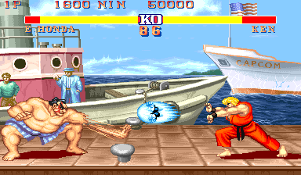
Game Playing
Game Playing
The minimax algorithm
Resource limitations
alpha-beta pruning
Elements of chance

Slide 2
What kind of games?
Abstraction: To describe a game we must capture every relevant aspect of the game. Such as:
Chess, Tic-Tac-Toe, others
Accessible environments: Such games are characterized by perfect information and completely observable
Search: game-playing then consists of a search through possible game positions
Unpredictable opponent: introduces uncertainty thus game-playing must deal with contingency problems

Slide 3
Searching for the Next Move
Complexity: many games have a huge search space
Chess: b = 35, m=100 ⇒ nodes = 35 ¹⁰⁰ if each node takes about 1 ns to explore then each move will take about 10 ⁵⁰ millennia to calculate.
Resource (e.g., time, memory) limit: optimal solution not feasible/possible, thus must approximate
Pruning: makes the search more efficient by discarding portions of the search tree that cannot improve quality result
Evaluation functions: heuristics to evaluate utility of a state without exhaustive search

Slide 4
Two-Player Games
A game formulated as a search problem:
Initial state: ?
Operators: ?
Terminal state: ?
Utility function: ?

Slide 5
Two-Player Games
A game formulated as a search problem:
Initial state: board position and turn
Operators: definition of legal moves
Terminal state: conditions for when game is over
Utility function: a numeric value that describes the outcome of the game. E.g., -1, 0, 1 for loss, draw, win. (AKA payoff function)

Slide 6
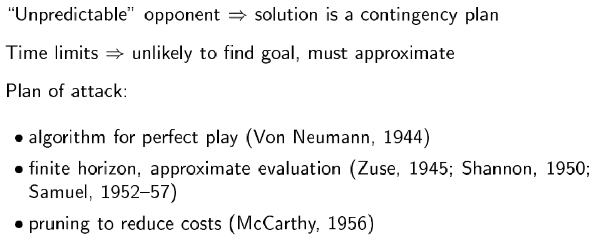
Game vs. Search Problem

Slide 7
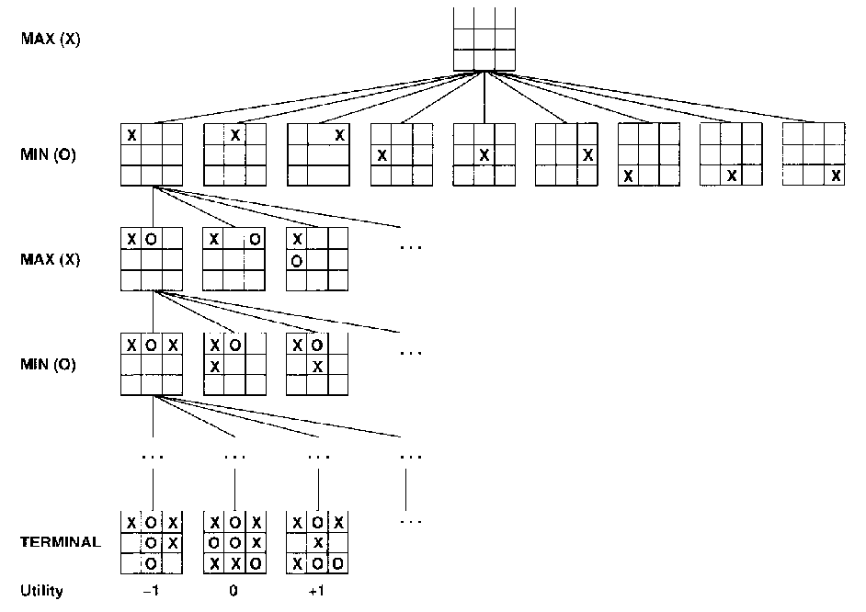
Example: Tic-Tac-Toe

Slide 8
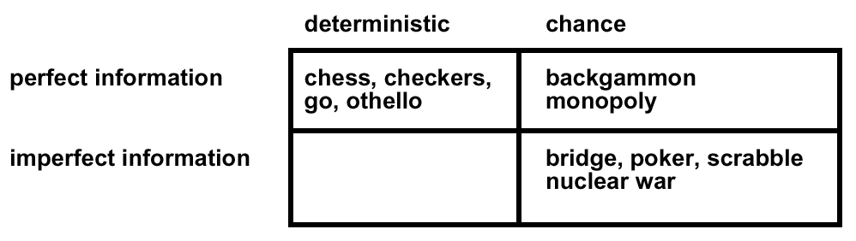
Type of Games

Slide 9
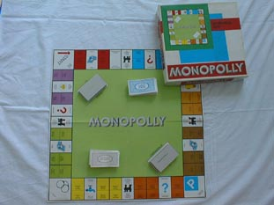
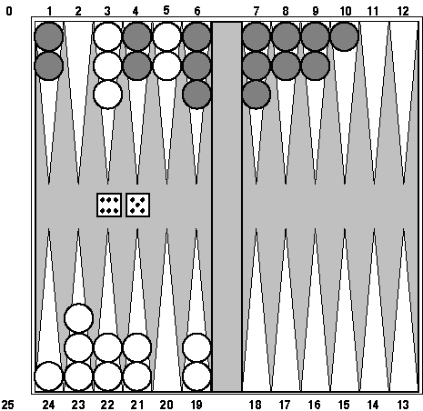
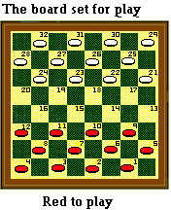
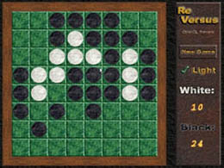


Type of Games

Slide 10
The Minimax Algorithm
Perfect play for deterministic environments with perfect information
Basic idea: choose move with highest minimax value = best achievable payoff against best play
Algorithm:
Generate game tree completely
Determine utility of each terminal state
Propagate the utility values upward in the three by applying MIN and MAX operators on the nodes in the current level
At the root node use minimax decision to select the move with the max (of the min) utility value
Steps 2 and 3 in the algorithm assume that the opponent will play perfectly.

Slide 11
Generate Game Tree

Slide 12
Generate Game Tree
x
 | x
x
 |  | x

Slide 13
Generate Game Tree
 | x
 | x | o
o | x
 | x
 | o
 | x
o

Slide 14
Generate Game Tree
 | x
1 ply
1 move
 | x | o
o | x
 | x
 | o
 | x
o

Slide 15
A Subtree
x
o
x
o
x
o
win
lose
x
o
x
x
o
x
x
o
x
draw
x
o
x
o
x
o
x
o
x
o
x
o
x
o
x
x
o
x
x
o
x
x
o
x
x
o
x
x
o
x
x
o
x
x
o
x
o
o
x
o
x
o
o
x
o
x
o
o
o
o
x
o
x
o
o
x
o
o
x
o
x
o
x
x
o
x
x
o
x
x
o
x
x
o
x
o
o
x
o
o
x
x
o
x
o
x
o
x
x
o
x
x
o
o
x
o

Slide 16
What is a Good Move?
x
o
x
o
x
o
win
lose
x
o
x
x
o
x
x
o
x
draw
x
o
x
o
x
o
x
o
x
o
x
o
x
o
x
x
o
x
x
o
x
x
o
x
x
o
x
x
o
x
x
o
x
x
o
x
o
o
x
o
x
o
o
x
o
x
o
o
o
o
x
o
x
o
o
x
o
o
x
o
x
o
x
x
o
x
x
o
x
x
o
x
x
o
x
o
o
x
o
o
x
x
o
x
o
x
o
x
x
o
x
x
o
o
x
o

Slide 17
Minimax
3
12
8
2
4
6
14
5
2
Minimize opponent’s chance
Maximize your chance

Slide 18
Minimax
3
2
2
MIN
3
12
8
2
4
6
14
5
2
Minimize opponent’s chance
Maximize your chance

Slide 19
Minimax
3
MAX
3
2
2
MIN
3
12
8
2
4
6
14
5
2
Minimize opponent’s chance
Maximize your chance

Slide 20
Minimax
3
MAX
3
2
2
MIN
3
12
8
2
4
6
14
5
2
Minimize opponent’s chance
Maximize your chance

Slide 21
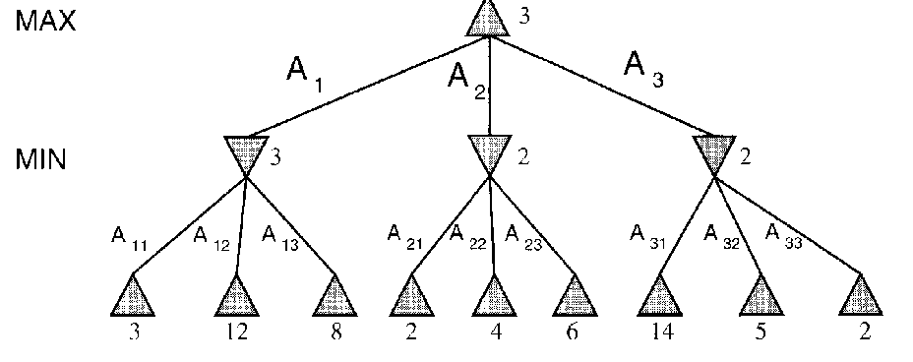
minimax = maximum of the minimum
1st ply
2nd ply

Slide 22
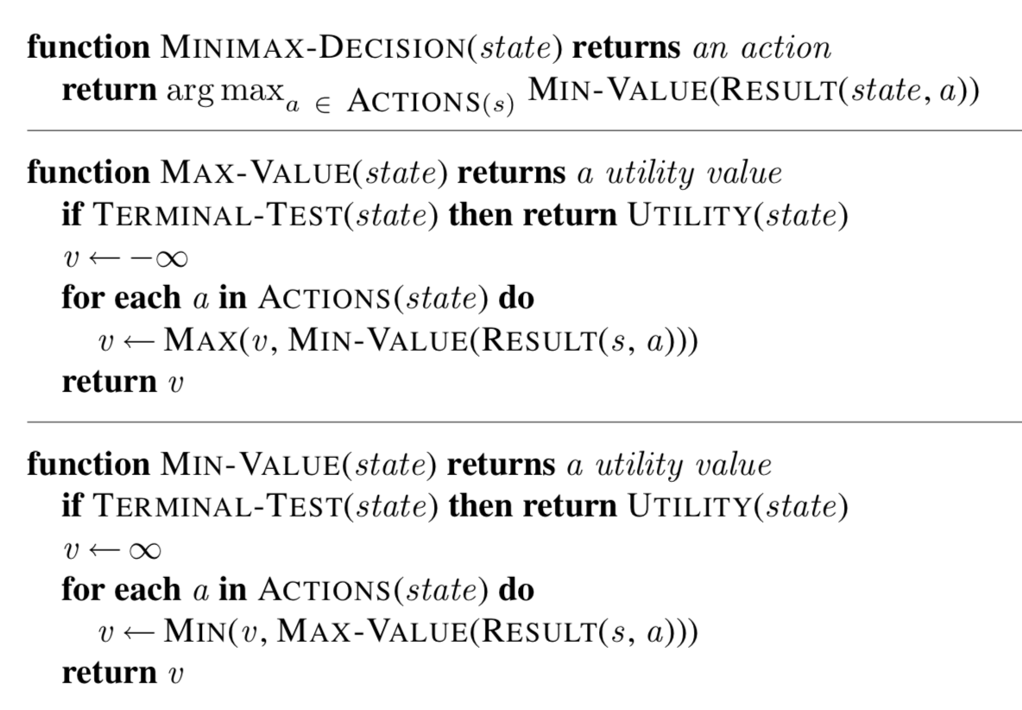
Minimax: Recursive implementation
Complete: ? Optimal: ?
Time complexity: ? Space complexity: ?

Slide 23
Minimax: Recursive implementation
Complete: Yes, for finite state-space Optimal: Yes
Time complexity: O(b^{m}) Space complexity: O(bm) (= DFS Does not keep all nodes in memory.)

Slide 24
Move Evaluation without Complete Search
Complete search is too complex and impractical
Evaluation function: evaluates value of state using heuristics and cuts off search
New MINIMAX:
CUTOFF-TEST: cutoff test to replace the termination condition (e.g., deadline, depth-limit, etc.)
EVAL: evaluation function to replace utility function (e.g., number of chess pieces taken)

Slide 25
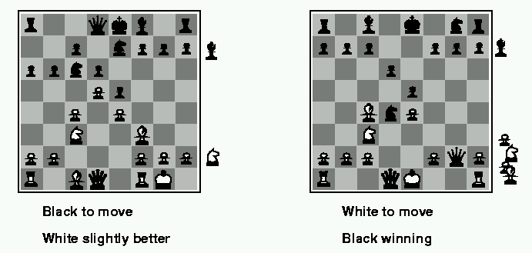
Evaluation Functions
Weighted linear evaluation function: to combine n heuristics f = w₁f₁ ₊ w₂f_{2 + … +} w_{n}f_{n}
E.g, w’s could be the values of pieces (1 for prawn, 3 for bishop etc.) f’s could be the number of type of pieces on the board

Slide 26
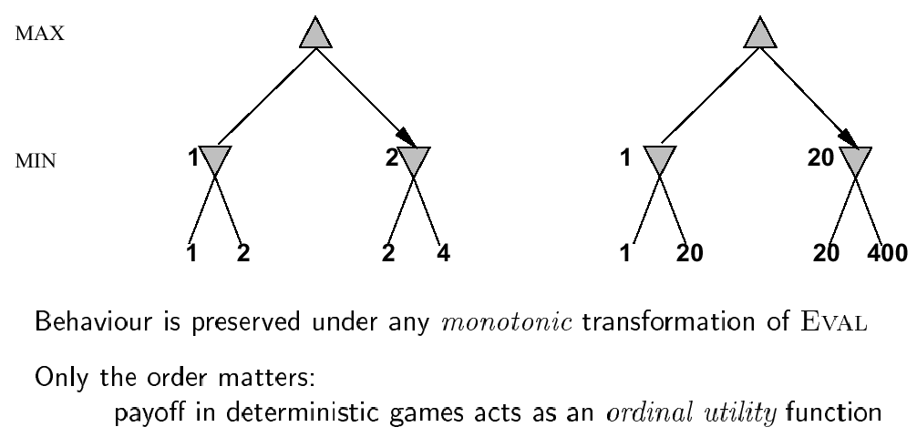
Note: Exact Values do not Matter (Relative Orders are important)

Slide 27
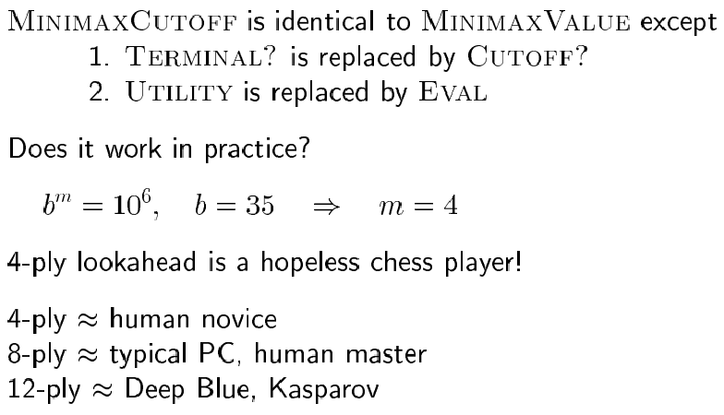
Minimax with Cutoff: Viable Algorithm?
Assume we have 100 seconds, evaluate 10⁴ nodes/s; can evaluate 10⁶ nodes/move

Slide 28
Reduce Search: α-β pruning for search cutoff
Pruning: eliminating a branch of the search tree from consideration without exhaustive examination of each node
α-β pruning: the basic idea is to prune portions of the search tree that cannot improve the utility value of the max or min node, by just considering the values of nodes seen so far.
Does it work? Yes, in roughly cuts the branching factor from b to √b resulting in double as far look-ahead than pure minimax

Slide 29
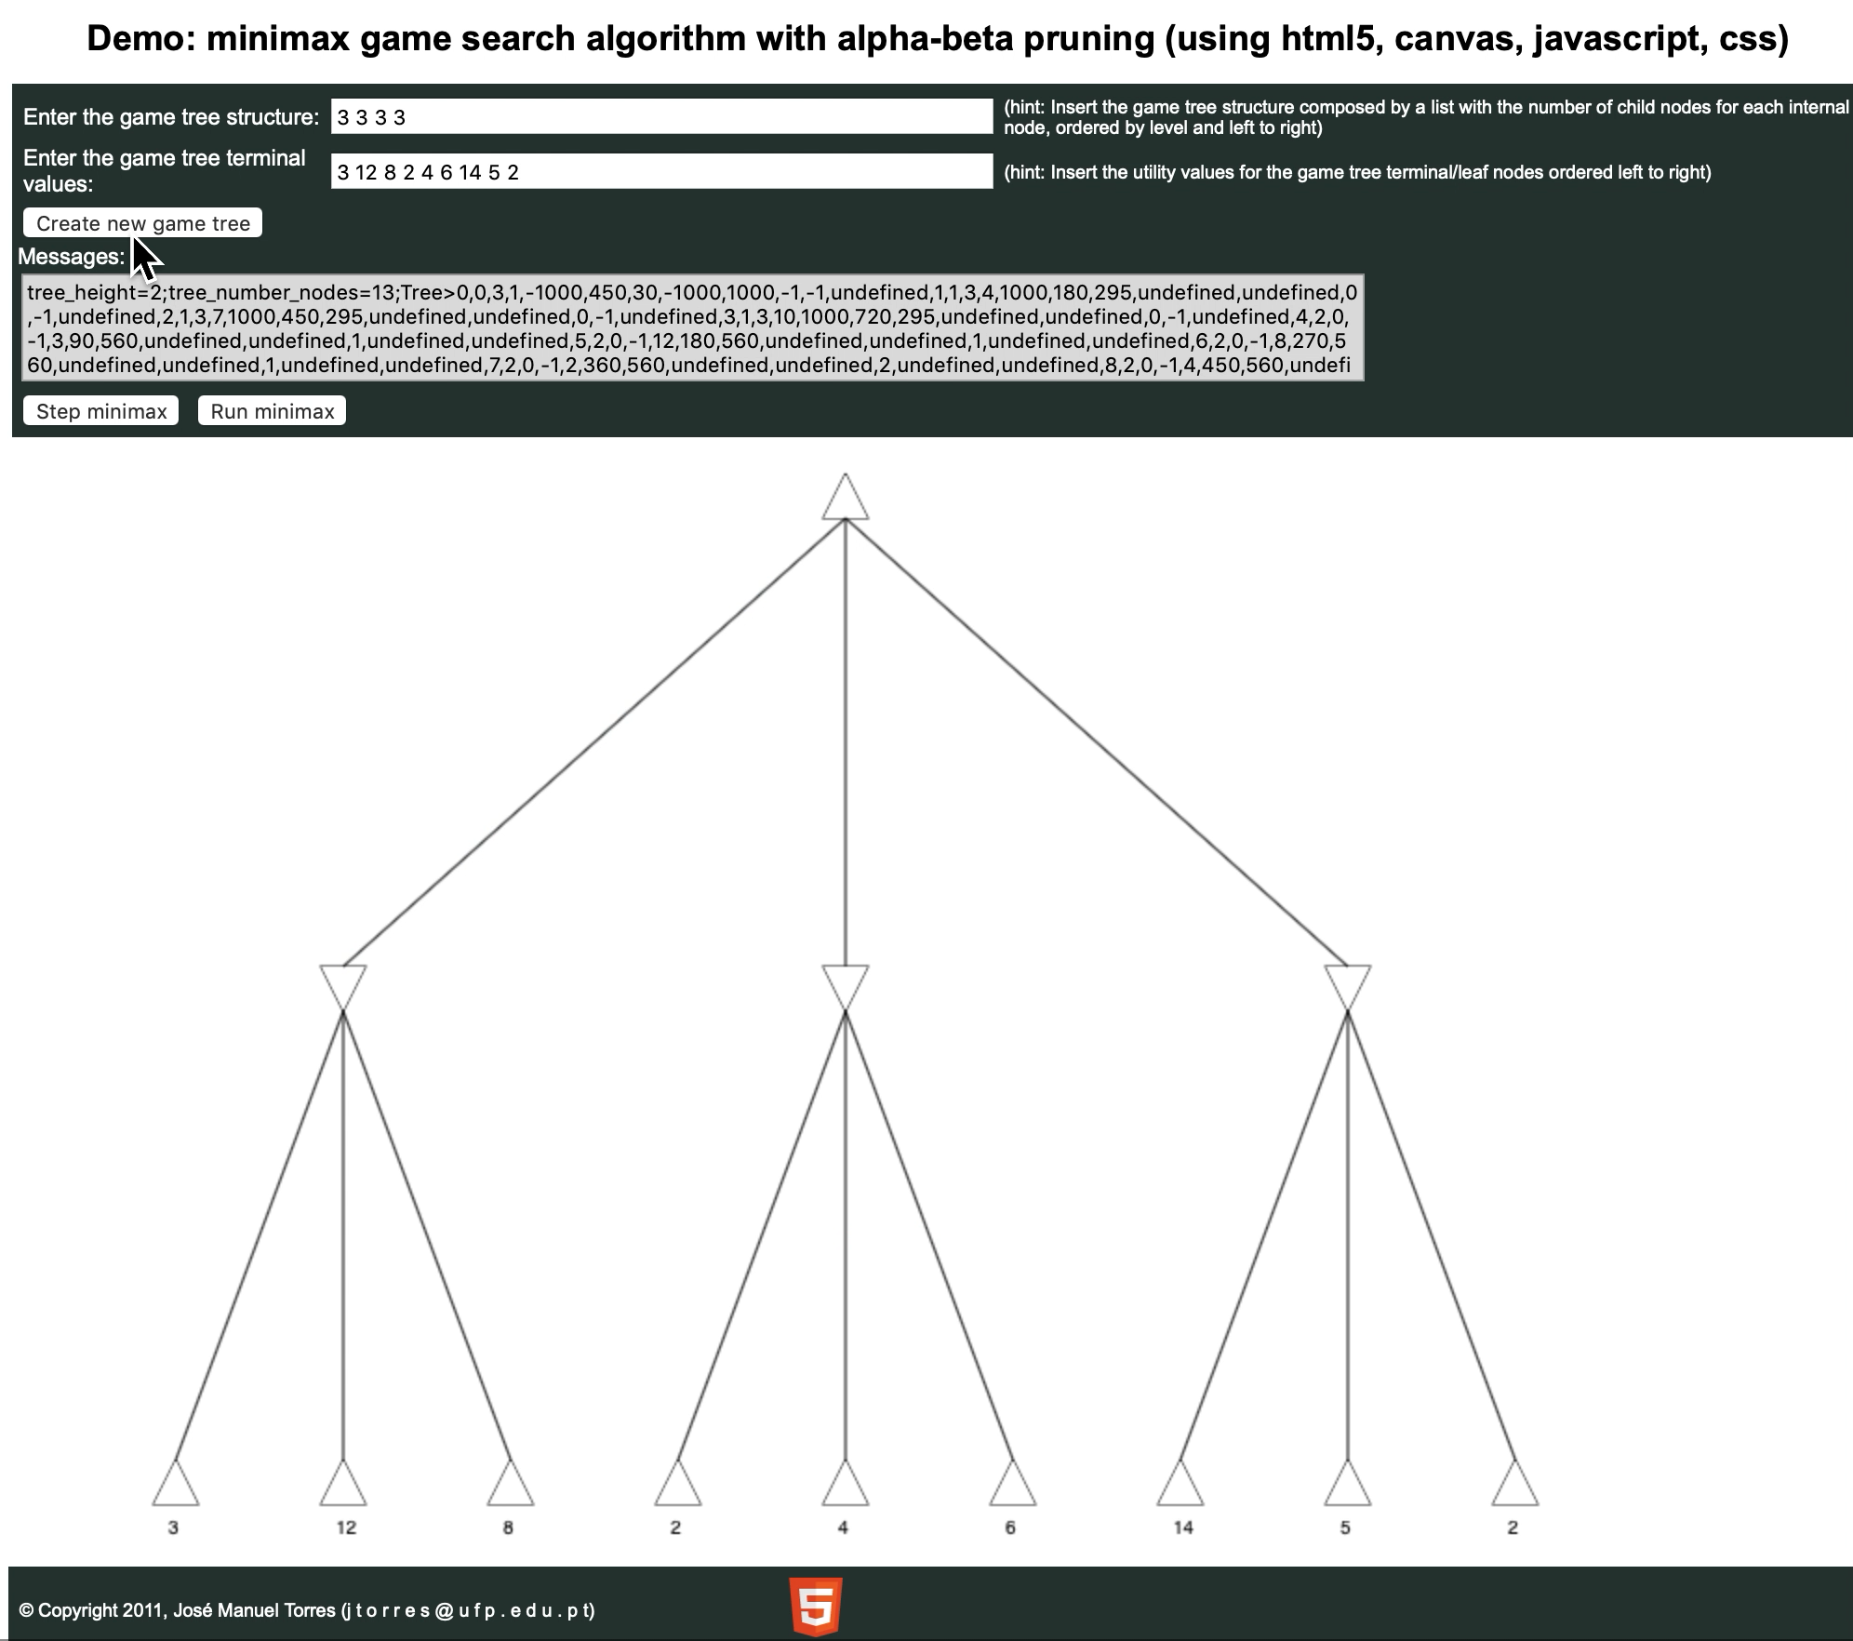
Demo
http://homepage.ufp.pt/jtorres/ensino/ia/alfabeta.html

Slide 30
α-β pruning: example
≥ 6
MAX
MIN
6
6
12
8

Slide 31
α-β pruning: example
≥ 6
MAX
MIN
6
≤ 2
6
12
8
2

Slide 32
α-β pruning: example
≥ 6
MAX
MIN
6
≤ 2
≤ 5
6
12
8
2
5

Slide 33
α-β pruning: example
≥ 6
MAX
Selected move
MIN
6
≤ 2
≤ 5
6
12
8
2
5
Interactive demo:
https://www.yosenspace.com/posts/computer-science-game-trees.html

Slide 34
α-β pruning: general principle
Player
m
α
Opponent
If α > v then MAX will chose m so prune tree under n
Similar for β for MIN
Player
Opponent
n
v

Slide 35
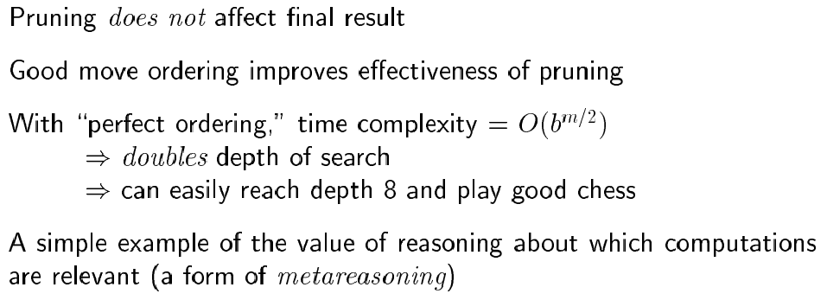
Properties of α-β

Slide 36
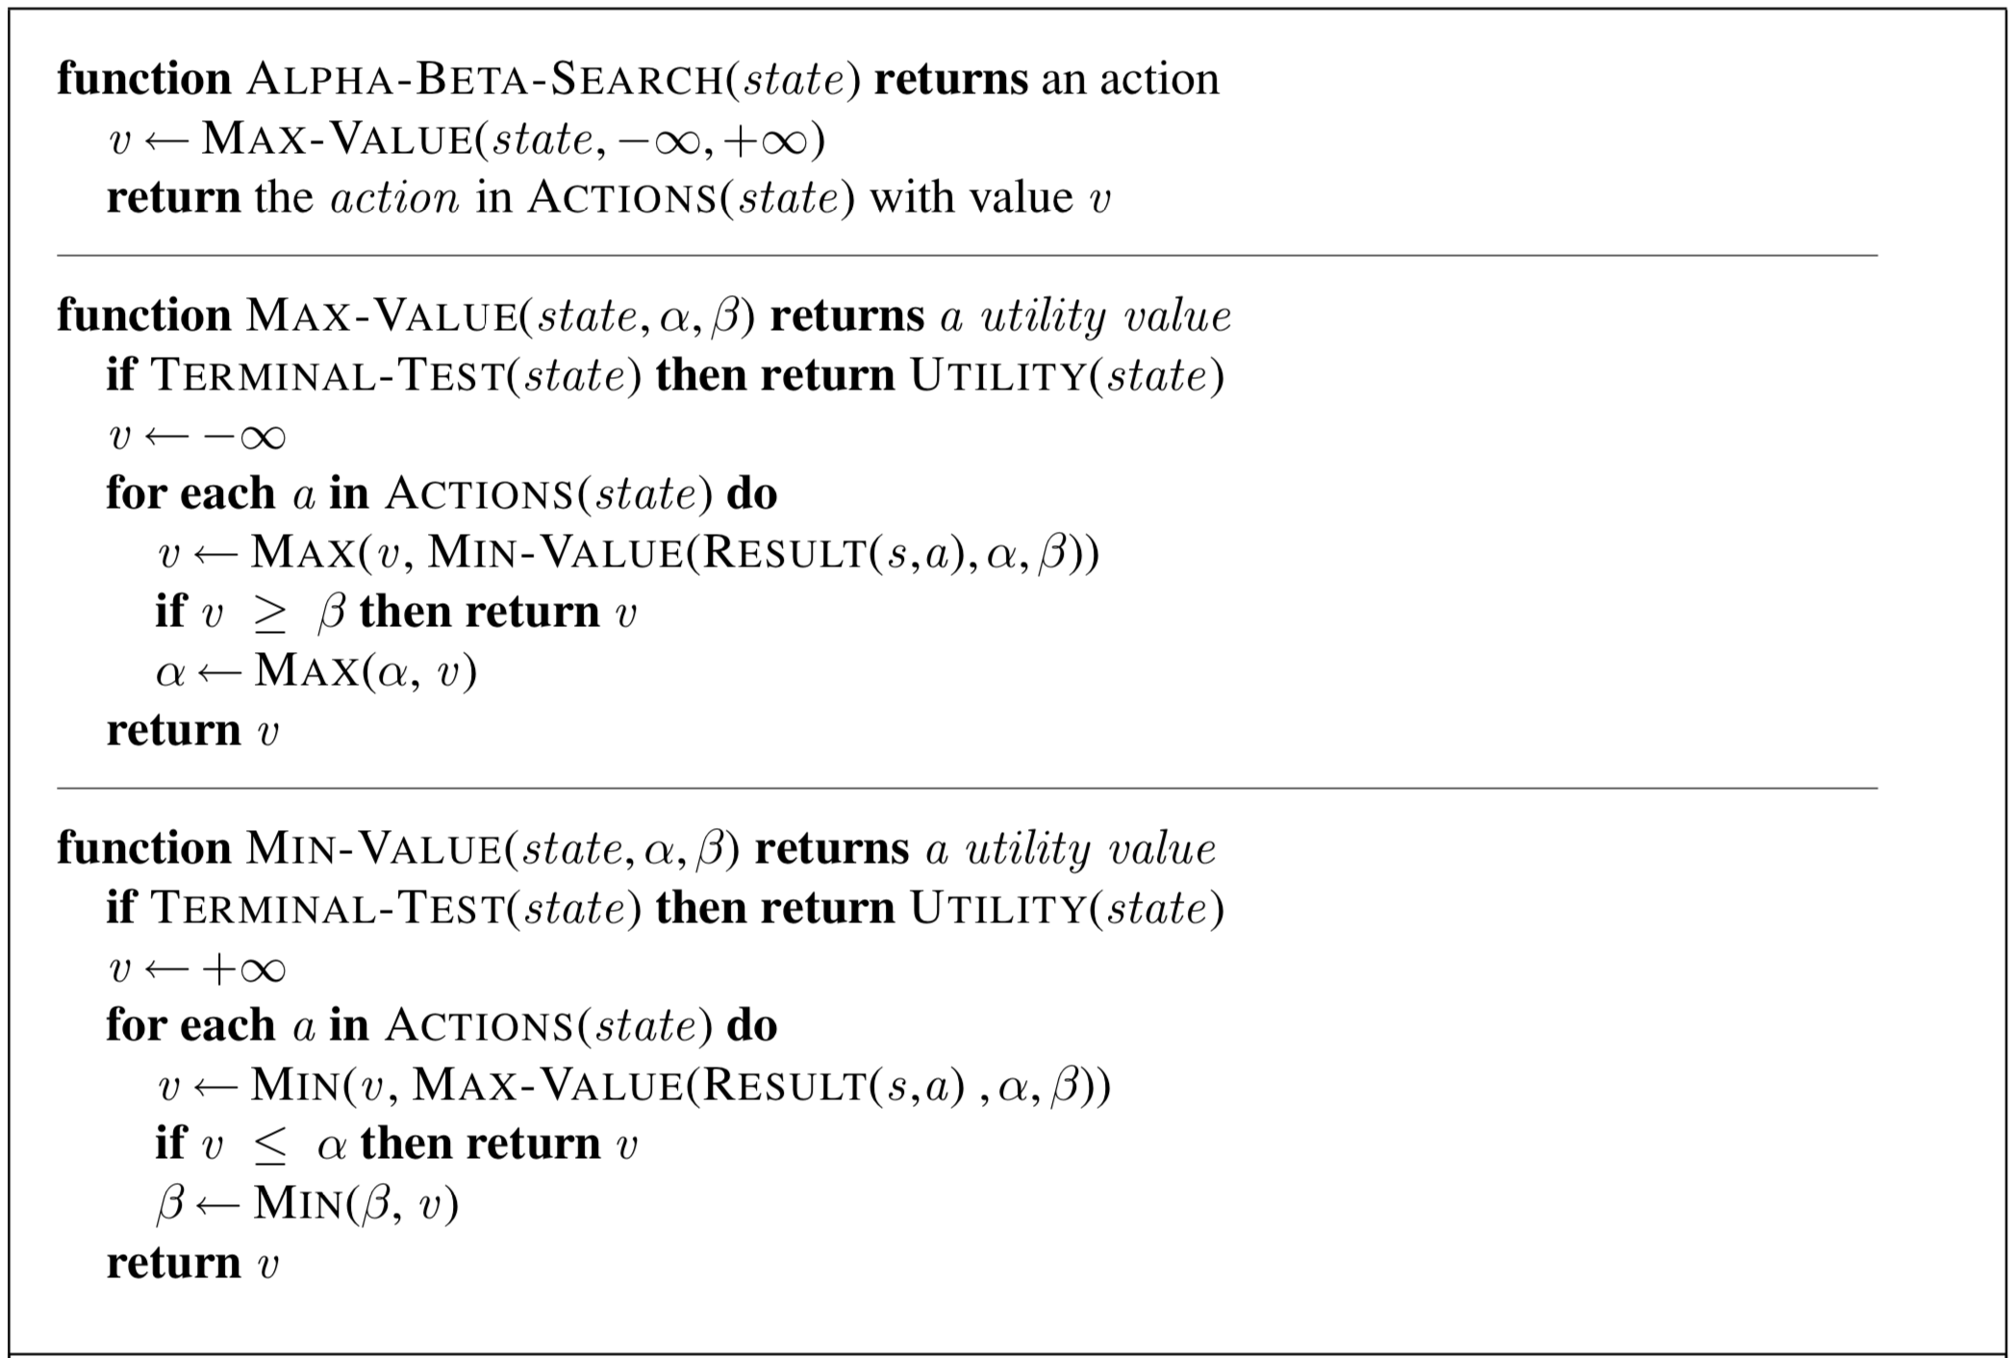
The α-β algorithm

Slide 37
More on the α-β algorithm
Same basic idea as minimax, but prune (cut away) branches of the tree that we know will not contain the solution.
We know a branch will not contain a solution once we know a better outcome has already been discovered in a previously explored branch.

Slide 38
Remember: Minimax: Recursive implementation
Complete: Yes, for finite state-space Optimal: Yes
Time complexity: O(b^{m}) Space complexity: O(bm) (= DFS Does not keep all nodes in memory.)

Slide 39
The α-β algorithm

Slide 40
More on the α-β algorithm
Same basic idea as minimax, but prune (cut away) branches of the tree that we know will not contain the solution.
Because minimax is depth-first, let’s consider nodes along a given path in the tree. Then, as we go along this path, we keep track of:
α : Best choice so far for MAX
β : Best choice so far for MIN

Slide 41
The α-β algorithm
Note: α and β are both
Local variables. At the
Start of the algorithm,
We initialize them to
α = -∞ and β = +∞

Slide 42
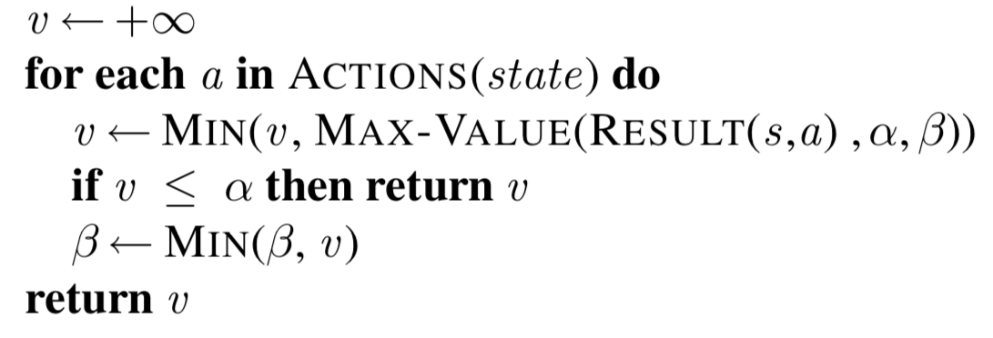
More on the α-β algorithm
In Min-Value:
α = -∞
β = +∞
MAX
Max-Value loops
over these
…
Min-Value loops
over these
MIN
5 10 6 2 8 7
α = -∞
β = 5
α = -∞
β = 5
α = -∞
β = 5
Return v=5

Slide 43
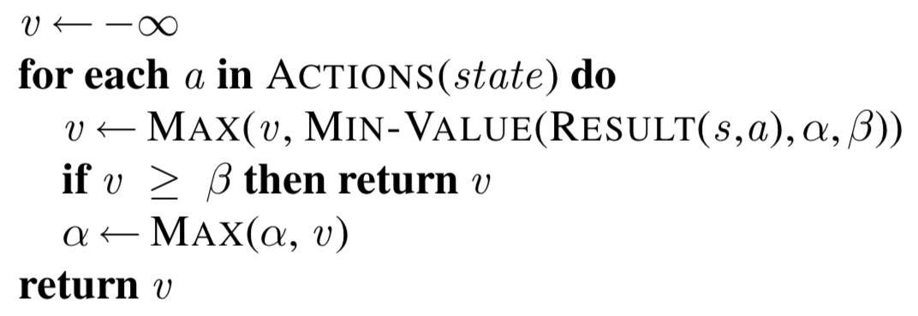
More on the α-β algorithm
In Max-Value:
// or v ≤ α
MAX
Max-Value loops
over these
α = 5
β = +∞
MIN
…
Return v=5
MAX
5 10 6 2 8 7
α = -∞
β = 5
α = -∞
β = 5
α = -∞
β = 5

Slide 44
More on the α-β algorithm
In Min-Value:
MAX
α = 5
β = +∞
MIN
…
Min-Value loops
over these
MAX
5 10 6 2 8 7
α = -∞
β = 5
α = -∞
β = 5
α = -∞
β = 5
α = 5
β = +∞
End loop and return 2

Slide 45
More on the α-β algorithm
In Max-Value:
// or v ≤ α
MAX
Max-Value loops
over these
α = 5
β = +∞
α = 5
β = +∞
MIN
…
Return v=2
MAX
5 10 6 2 x x
α = -∞
β = 5
α = -∞
β = 5
α = -∞
β = 5
α = 5
β = +∞

Slide 46
Another way to understand the algorithm
For a given node N,
α is the value of N to MAX
β is the value of N to MIN

Slide 47
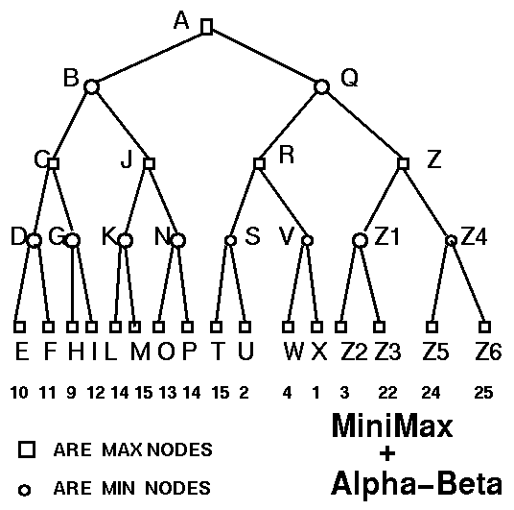
Example

Slide 48
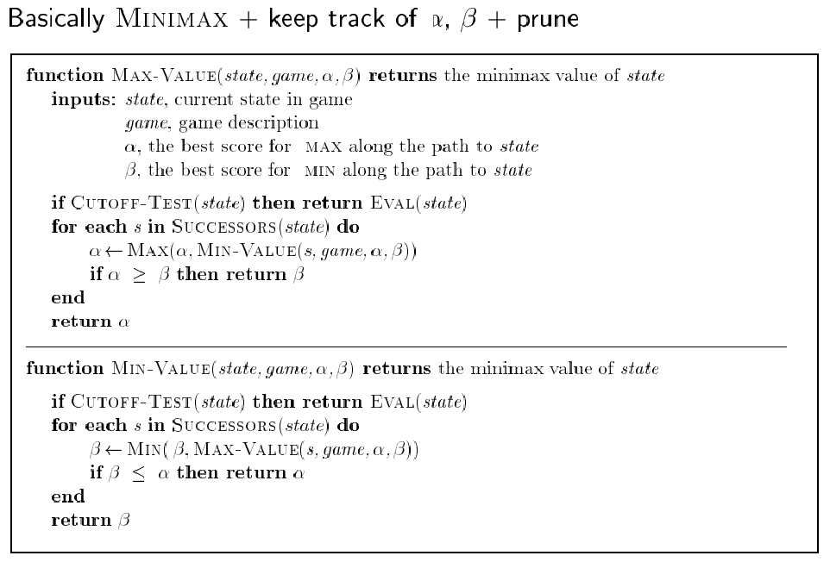
α-β algorithm: slight variant (from earlier version of textbook)
Is this wrong compared to latest version of textbook?
Please always use latest version of the algorithm as in 3rd edition of textbook.

Slide 49
Solution
NODE TYPE ALPHA BETA SCORE
A MAX -Inf Inf
B MIN -Inf Inf
C MAX -Inf Inf
D MIN -Inf Inf
E MAX 10 10 10
D MIN -Inf 10
F MAX 11 11 11
D MIN -Inf 10 10
C MAX 10 Inf
G MIN 10 Inf
H MAX 9 9 9
G MIN 10 9 9
C MAX 10 Inf 10
B MIN -Inf 10
J MAX -Inf 10
K MIN -Inf 10
L MAX 14 14 14
K MIN -Inf 10
M MAX 15 15 15
K MIN -Inf 10 10
…
NODE TYPE ALPHA BETA SCORE
…
J MAX 10 10 10
B MIN -Inf 10 10
A MAX 10 Inf
Q MIN 10 Inf
R MAX 10 Inf
S MIN 10 Inf
T MAX 15 15 15
S MIN 10 15
U MAX 2 2 2
S MIN 10 2 2
R MAX 10 Inf
V MIN 10 Inf
W MAX 4 4 4
V MIN 10 4 4
R MAX 10 Inf 10
Q MIN 10 10 10
A MAX 10 Inf 10

Slide 50
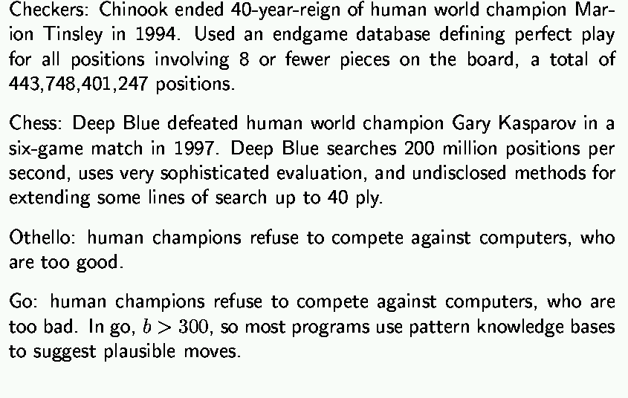
State-of-the-art for deterministic games
After 2020:
Alpha-GO
Win !!
Before 2020

Slide 51
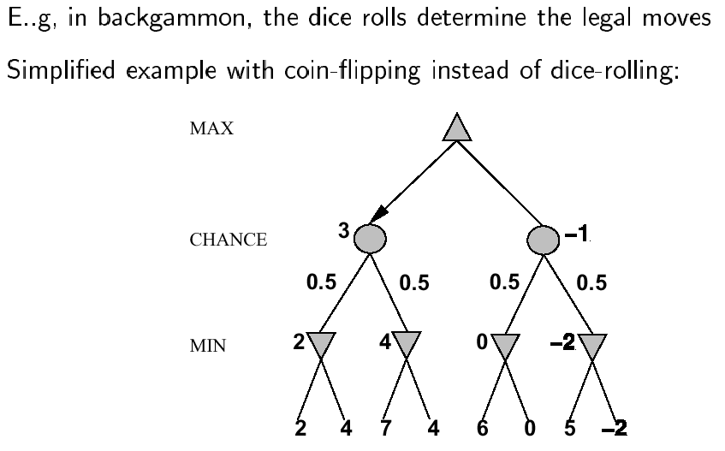
Nondeterministic games

Slide 52
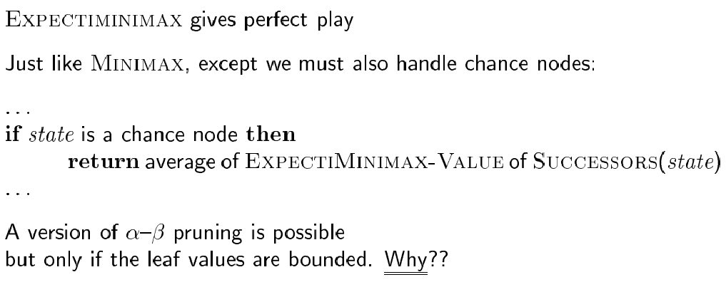
Algorithm for nondeterministic games

Slide 53
Remember: Minimax algorithm

Slide 54
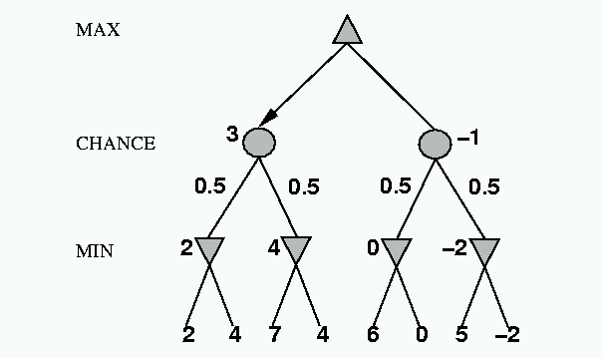
Nondeterministic games: the element of chance
expectimax and expectimin, expected values over all possible outcomes
CHANCE
?
0.5
0.5
3
?
?
8
17
8

Slide 55
Nondeterministic games: the element of chance
4 = 0.5*3 + 0.5*5
Expectimax
CHANCE
0.5
0.5
5
3
5
Expectimin
8
17
8

Slide 56
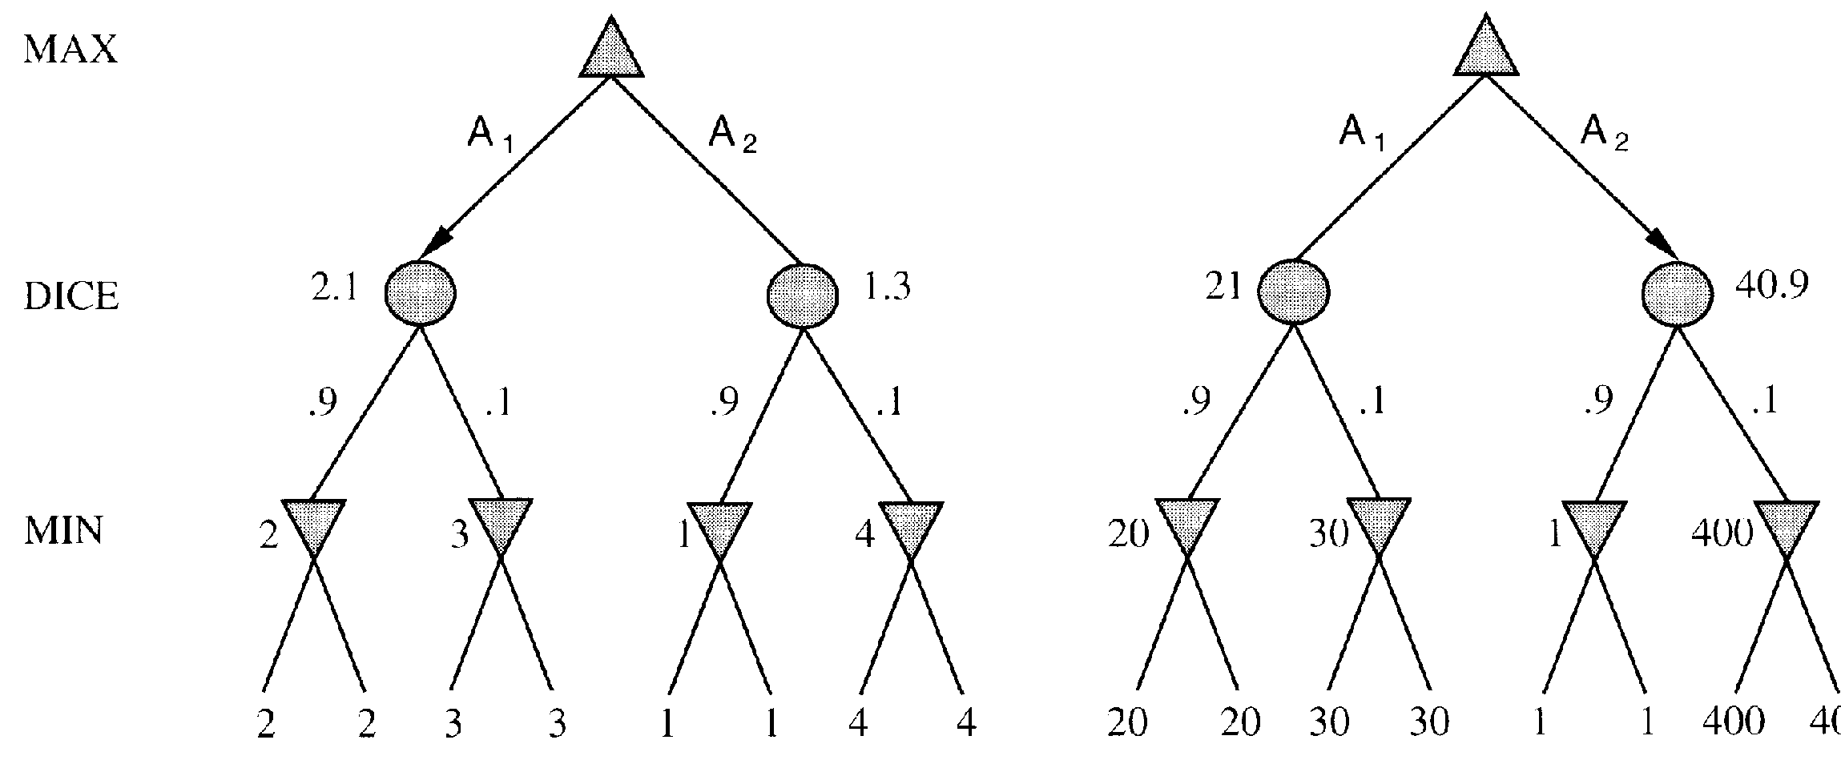
Evaluation functions: Exact values DO matter
Order-preserving transformation do not necessarily behave the same!

Slide 57
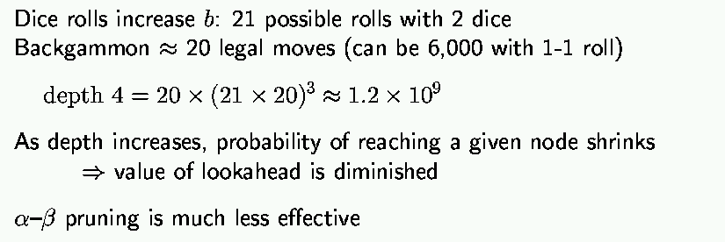
State-of-the-art for nondeterministic games

Slide 58
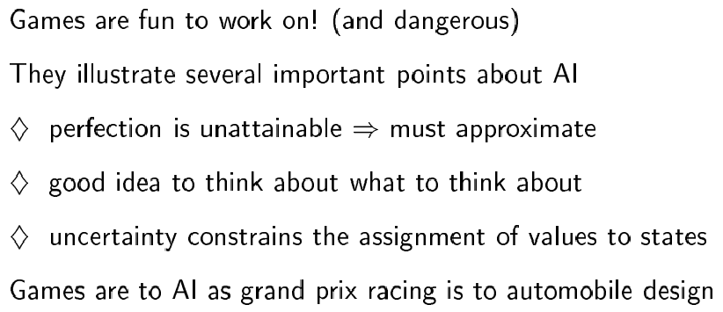
Summary

Slide 59
Exercise: Game Playing
Consider the following game tree in which the evaluation function values are shown below each leaf node. Assume that the root node corresponds to the maximizing player. Assume the search always visits children left-to-right.
(a) Compute the backed-up values computed by the minimax algorithm. Show your answer by writing values at the appropriate nodes in the above tree.
(b) Compute the backed-up values computed by the alpha-beta algorithm. What nodes will not be examined by the alpha-beta pruning algorithm?
(c) What move should Max choose once the values have been backed-up all the way?
A
Max
B
C
Min
D
E
F
G
H
I
J
K
Max
Min
L
M
N
O
P
Q
R
S
T
U
V
W
X
Y
2
3
8
5
7
6
0
1
5
2
8
4
10
2

